Slide 1
1
FUNCTIONS AND LIMITS
.

Slide 2
1.5
Continuity

Slide 3

Continuity
The limit of a function as x approaches a can often be found simply by calculating the value of the function at a.
Functions with this property are called continuous at a.

Slide 4
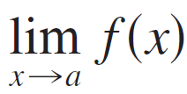
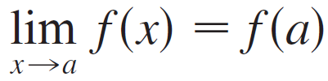
Continuity
Notice that Definition 1 implicitly requires three things if f is continuous at a :
1. f (a ) is defined (that is, a is in the domain of f )
2. exists
3.

Slide 5
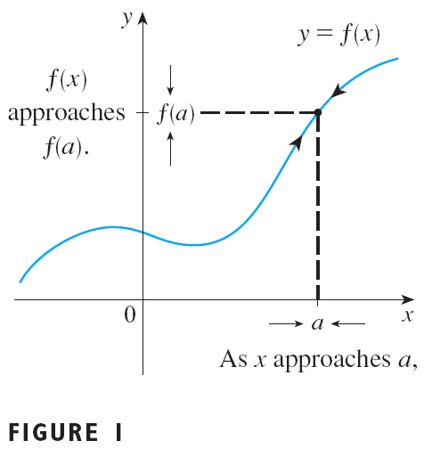
Continuity
The definition says that f is continuous at a if f (x) approaches f (a) as x approaches a.
Thus a continuous function f has the
property that a small change in
produces only a small change in f (x ).
In fact, the change in f (x ) can be kept as small as we please by keeping the change in x sufficiently small.

Slide 6
Continuity
If f is defined near a (in other words, f is defined on an open interval containing a, except perhaps at a), we say that f is discontinuous at a (or f has a discontinuity at a) if f is not continuous at a.
Physical phenomena are usually continuous.
For instance, the displacement or velocity of a vehicle varies continuously with time, as does a person’s height.

Slide 7

Continuity
However, discontinuities do occur in such situations as electric currents.
See Example 6 in Section 1.3, where the Heaviside function is discontinuous at 0 because does not exist.
Geometrically, you can think of a function that is continuous at every number in an interval as a function whose graph has no break in it.
The graph can be drawn without removing your pen from the paper.

Slide 8
Example 1
The figure shows the graph of a function f. At which numbers is f discontinuous? Why?

Slide 9
Example 1 SOLUTION
It looks as if there is a discontinuity when a = 1 because the graph has a break there.
The official reason that f is discontinuous at 1 is that f(1) is not defined.

Slide 10
Example 1 SOLUTION
The graph also has a break when a = 3. However, the reason for the discontinuity is different.
Here, f(3) is defined, but does not exist (because the left and right limits are different).
So, f is discontinuous at 3.

Slide 11
Example 1 SOLUTION
What about a = 5?
Here, f(5) is defined and exists (because the left and right limits are the same).
However,
So, f is discontinuous at 5.

Slide 12
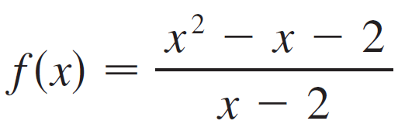
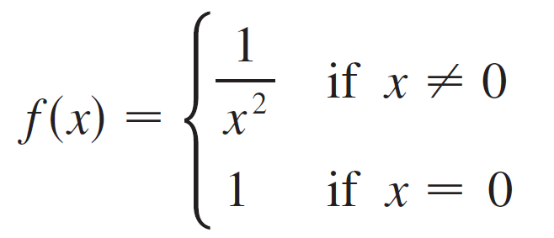
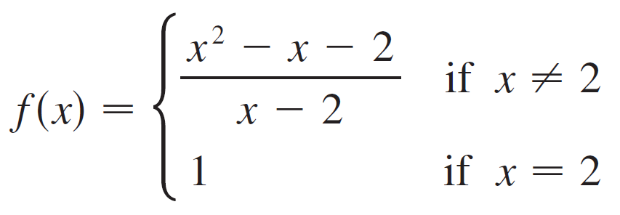

Example 2
Where are each of the following functions discontinuous?
(a)
(b)
(c)
(d)

Slide 13
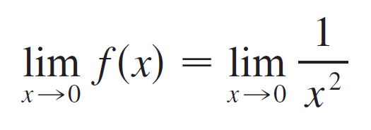
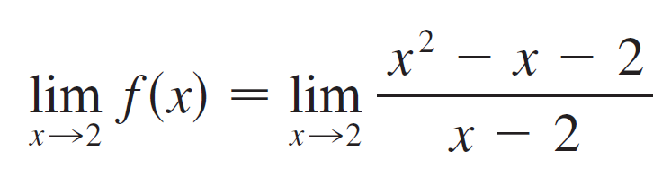
Example 2 – Solution
cont’d
(a) Notice that f (2) is not defined, so f is discontinuous at 2.
(b) Here f (0) = 1 is defined but
does not exist.
So f is discontinuous at 0.
(c) Here f (2) = 1 is defined and

Slide 14
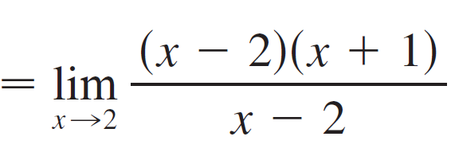
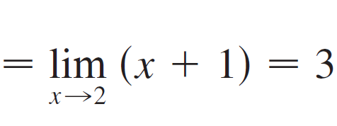
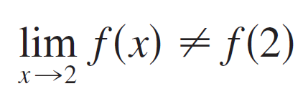
Example 2 – Solution
cont’d
exists.
But
so f is not continuous at 2.

Slide 15


Example 2 – Solution
cont’d
(d) The greatest integer function has discontinuities at all of the integers because does not exist if n is an integer.

Slide 16
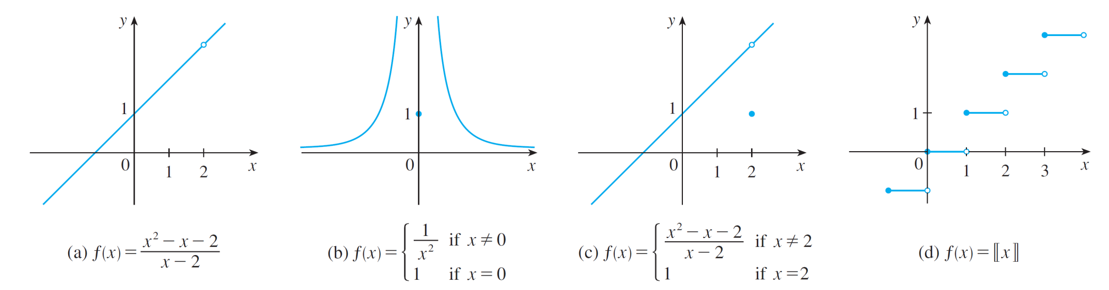
Continuity
Figure 3 shows the graphs of the functions in Example 2.
In each case the graph can’t be drawn without lifting the pen from the paper because a hole or break or jump occurs in the graph.
Graphs of the functions in Example 2
Figure 3

Slide 17
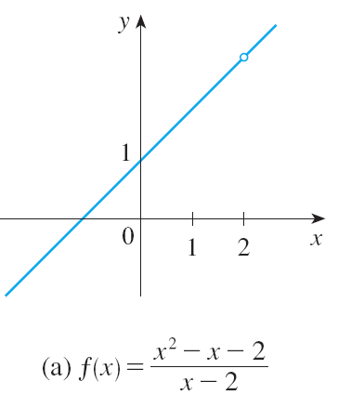
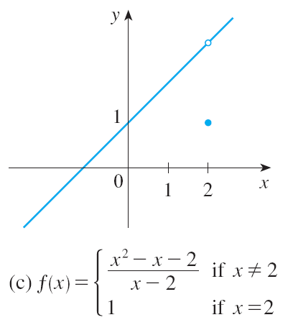
Continuity
The kind of discontinuity illustrated in parts (a) and (c) is called removable because we could remove the discontinuity by redefining f at just the single number 2. [The function g (x) = x + 1 is continuous.]

Slide 18
Continuity
The discontinuity in part (b) is called an infinite discontinuity.

Slide 19
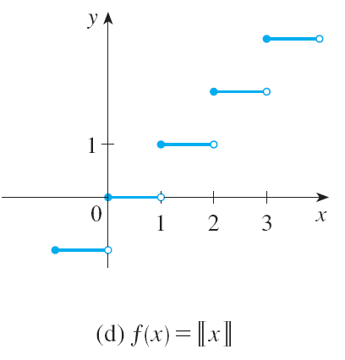
Continuity
The discontinuities in part (d) are called jump discontinuities because the function “jumps” from one value to another.

Slide 20
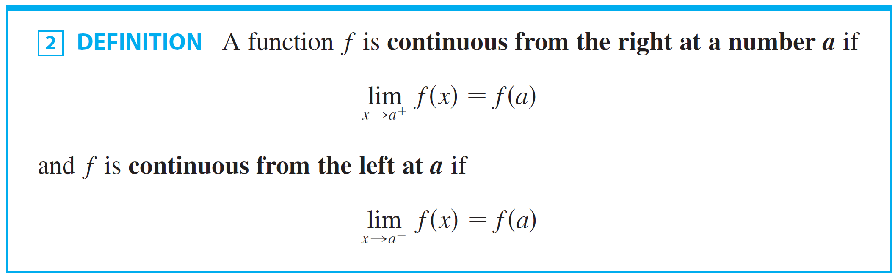
Definition 2

Slide 21
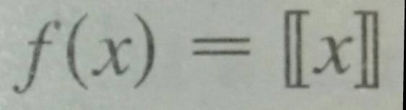
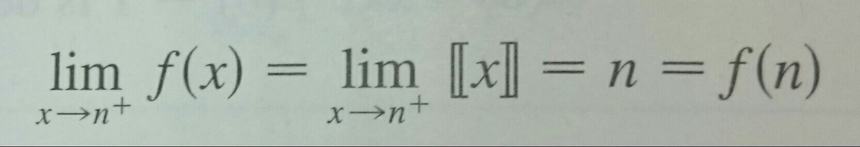
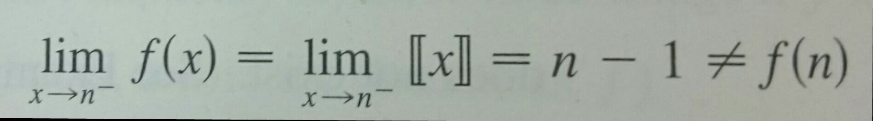
Example 3
At each integer n, the function is continuous from the right but discontinuous from the left because but

Slide 22
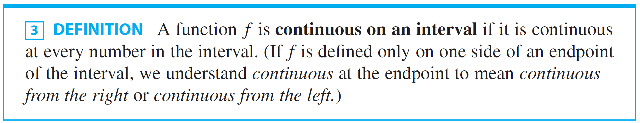
Definition 3

Slide 23
Example 4
Show that the function is continuous on the interval [– 1, 1].
SOLUTION
If –1 < a < 1, then using the Limit Laws, we have:

Slide 24
Example 4 – Solution
Thus, by Definition 1, f is continuous at a if – 1 < a < 1.
Similar calculations show that
So, f is continuous from the right at – 1 and continuous from the left at 1.
Therefore, according to Definition 3, f is continuous on [– 1, 1].

Slide 25
Example 4 – Solution
The graph of f is sketched in Figure 4.
It is the lower half of the circle

Slide 26
Continuity
Instead of always using Definitions 1, 2, and 3 to verify the continuity of a function, as we did in Example 4, it is often convenient to use the next theorem.
It shows how to build up complicated continuous functions from simple ones.

Slide 27
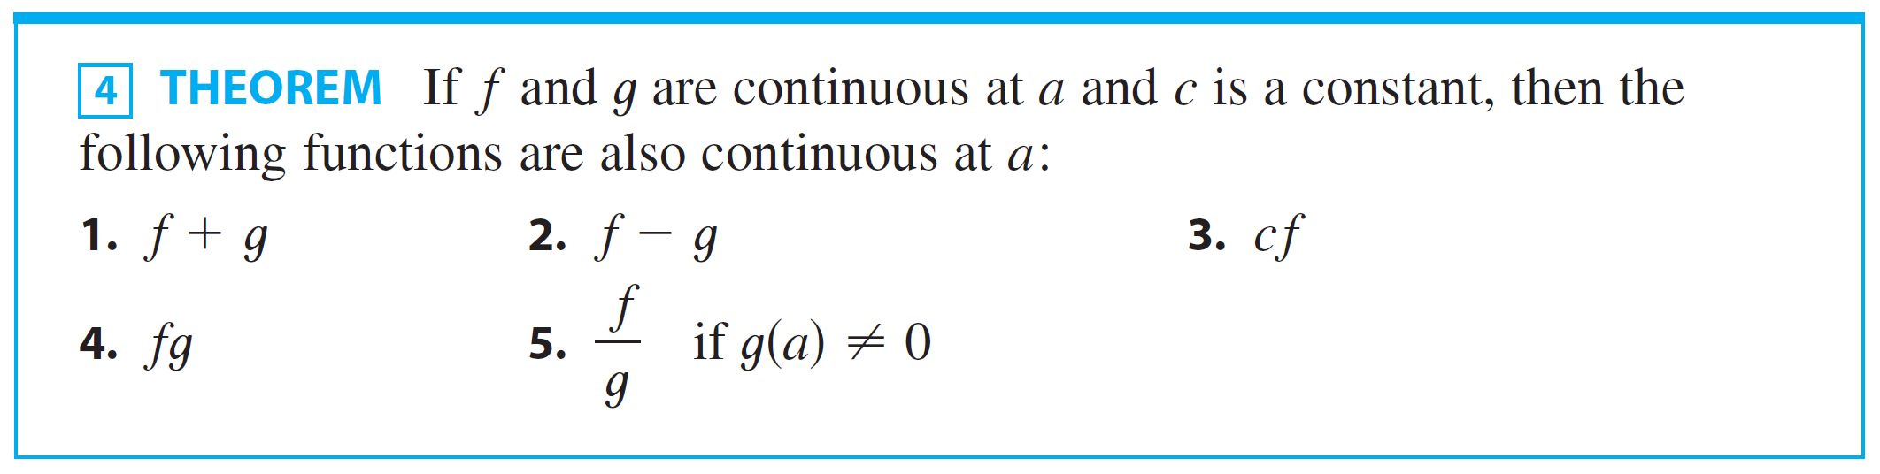
Continuity

Slide 28
Theorem 4 – Proof
Each of the five parts of the theorem follows from the corresponding Limit Law in Section 1.4.
For instance, we give the proof of part 1.

Slide 29
Theorem 4 – Proof
Since f and g are continuous at a, we have:
Therefore,
This shows that f + g is continuous at a.

Slide 30
Continuity
It follows from Theorem 4 and Definition 3 that if f and g are continuous on an interval, then so are the functions
f + g, f – g, cf, fg and (if g is never 0) f/g.
The following theorem was stated as the Direct Substitution Property.

Slide 31
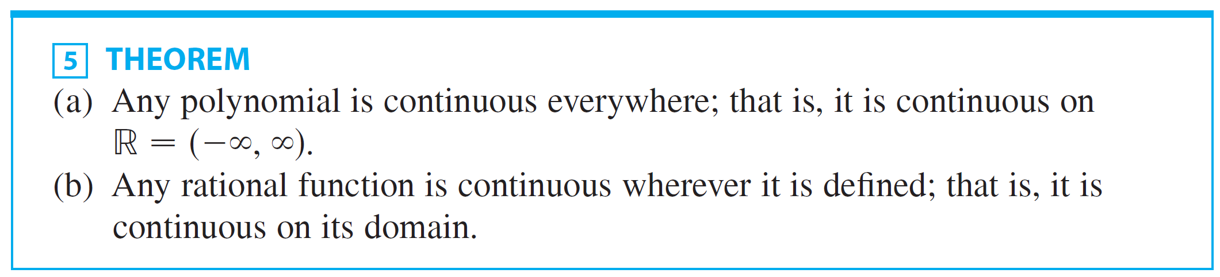
Theorem 5

Slide 32
Theorem 5(a) – Proof
A polynomial is a function of the form where c₀, c₁, …, c_{n} are constants.
We know that and
This equation is precisely the statement that the function f(x) = x^{m} is a continuous function.

Slide 33
Theorem 5(a) – Proof
Thus, by part 3 of Theorem 4, the function g(x) = cx^{m} is continuous.
Since P is a sum of functions of this form and a constant function, it follows from part 1 of Theorem 4 that P is continuous.

Slide 34
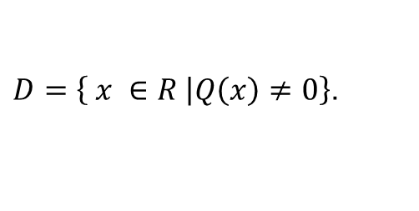
Theorem 5(b) – Proof
A rational function is a function of the form where P and Q are polynomials.
The domain of f is
We know from Proof (a) that P and Q are continuous everywhere.
Thus, by part 5 of Theorem 4, f is continuous at every number in D.
$\left.D=\left\{ x ∈R \right|Q\left(x\right)≠0\right\}$.

Slide 35
CONTINUITY
As an illustration of Theorem 5, observe that the volume of a sphere varies continuously with its radius.
This is because the formula shows that V is a polynomial function of r.

Slide 36
CONTINUITY
Similarly, if a ball is thrown vertically into the air with a velocity of 50 ft/s, then the height of the ball in feet t seconds later is given by the formula h = 50t – 16t².
Again, this is a polynomial function.
So, the height is a continuous function of the elapsed time.

Slide 37
CONTINUITY
Knowledge of which functions are continuous enables us to evaluate some limits very quickly— as the following example shows.
Compare it with Example 1(b) in Section 1.4.

Slide 38
Example 5
Find
SOLUTION:
The function is rational.
So, by Theorem 5, it is continuous on its domain, which is:
Therefore,

Slide 39
CONTINUITY
It turns out that most of the familiar functions are continuous at every number in their domains.
For instance, Limit Law 10 (page 36) is exactly the statement that root functions are continuous.

Slide 40
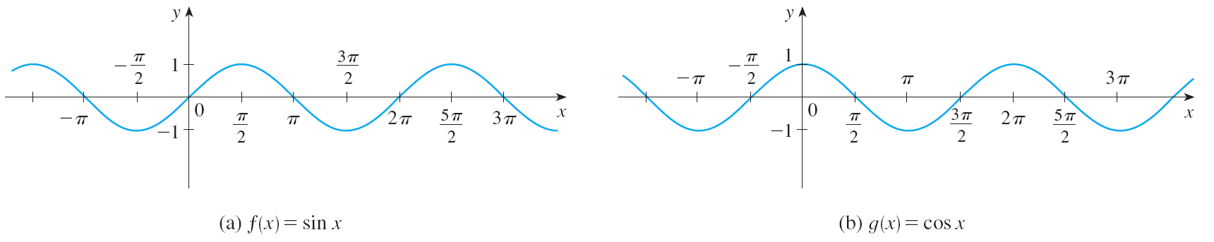
CONTINUITY
From the appearance of the graphs of the sine and cosine functions (Figure 11 in Section 1.2), we would certainly guess that they are continuous.

Slide 41
CONTINUITY
And in Section 1.4 we showed that
In other words, the sine and cosine functions are continuous everywhere.
It follows from part 5 of Theorem 4 that is continuous except where cos x = 0.

Slide 42
CONTINUITY
This happens when x is an odd integer multiple of π/2, so y = tan x has infinite discontinuities when x = ±π/2 , ±3π/2 , ±5π/2 and so on (see Figure 5).

Slide 43
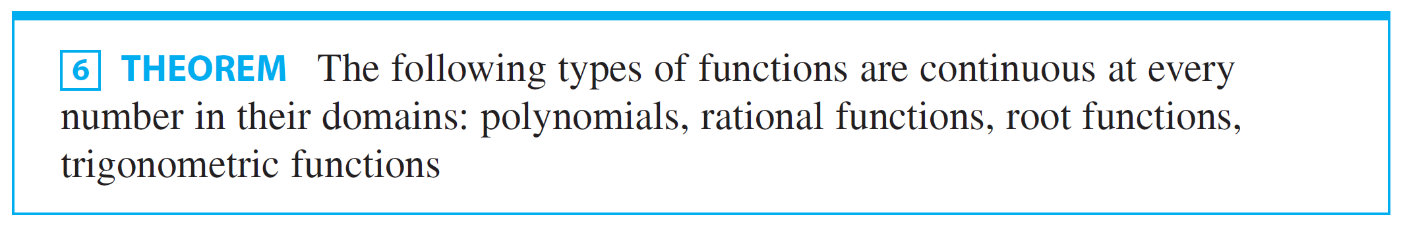
Continuity

Slide 44

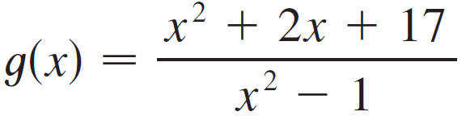
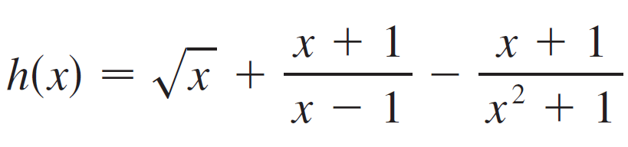
Example 6
On what intervals is each function continuous?
(a)
(b)
(c)

Slide 45

Example 6 – Solution
f is a polynomial, so it is continuous on ( , ) by Theorem 5(a).
g is a rational function, so by Theorem 5(b) it is continuous on its domain, which is
Thus g is continuous on the intervals ( , –1), (–1, 1),
and (1, ).

Slide 46
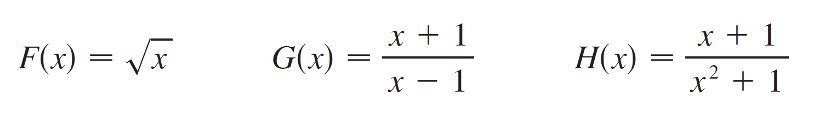
Example 6 – Solution
(c) We can write h(x) = F(x) + G(x) – H(x), where
F is continuous on [0, ) by Theorem 6.
G is a rational function, so it is continuous everywhere except when x – 1 = 0, that is, x = 1.
H is also a rational function, but its denominator is never 0, so H is continuous everywhere.

Slide 47
Example 6 – Solution
cont’d
Thus, by parts 1 and 2 of Theorem 4, h is continuous on the intervals [0, 1) and (1, ).

Slide 48
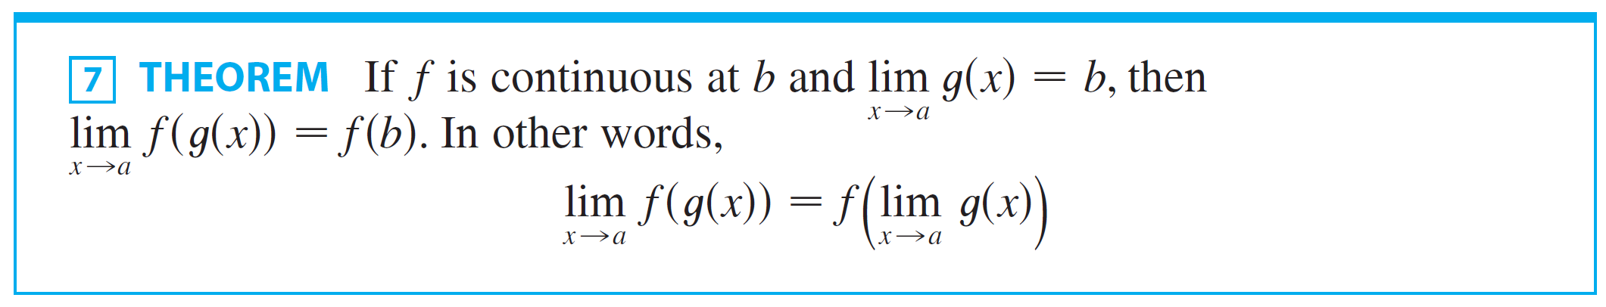
Theorem 7
Another way of combining continuous functions f and g to get a new continuous function is to form the composite function f ° g.
This fact is a consequence of the following theorem.

Slide 49
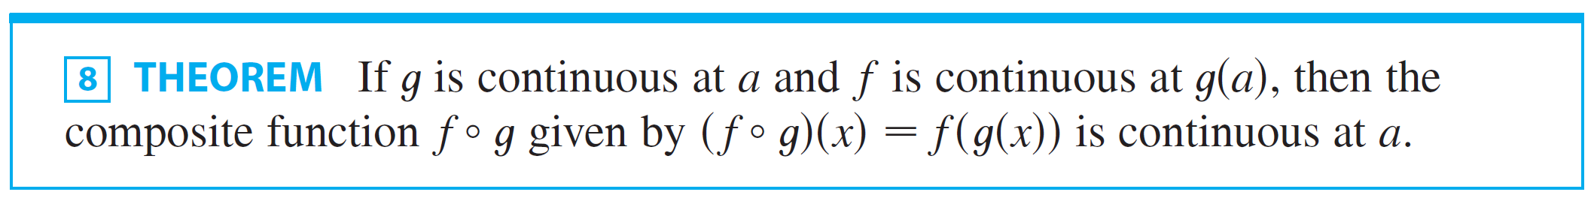
Theorem 8
Intuitively, Theorem 7 is reasonable because if x is close to a, then g (x ) is close to b, and since f is continuous at b, if g (x ) is close to b, then f (g (x )) is close to f (b ).
This theorem is often expressed informally by saying “a continuous function of a continuous function is a continuous function.”

Slide 50
Theorem 8 – Proof
Since g is continuous at a, we have
Since f is continuous at b = g(a), we can apply Theorem 7 to obtain
This is precisely the statement that the function
h(x) = f(g(x)) is continuous at a— that is, f ° g is continuous at a.

Slide 51
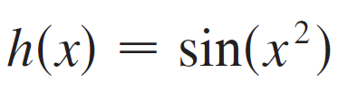
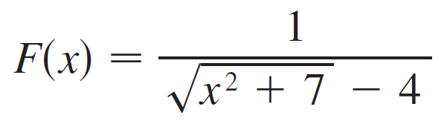
Example 7
Where are the following functions continuous?
(a)
(b)
Solution:
We have h(x) = f (g (x)), where

Slide 52

Example 7 – Solution
cont’d
Now g is continuous on since it is a polynomial, and f is also continuous every-where by Theorem 6.
Thus h = f ° g is continuous on by Theorem 8.
(b) Notice that F can be broken up as the composition of four continuous functions:
where

Slide 53
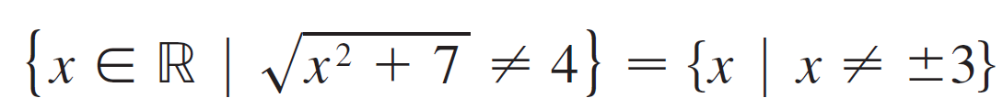
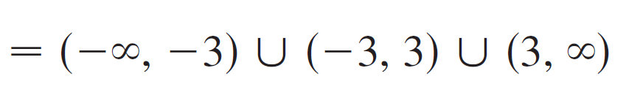
Example 7 – Solution
cont’d
We know that each of these functions is continuous on its domain (by Theorems 5 and 6), so by Theorem 8,
F is continuous on its domain, which is

Slide 54
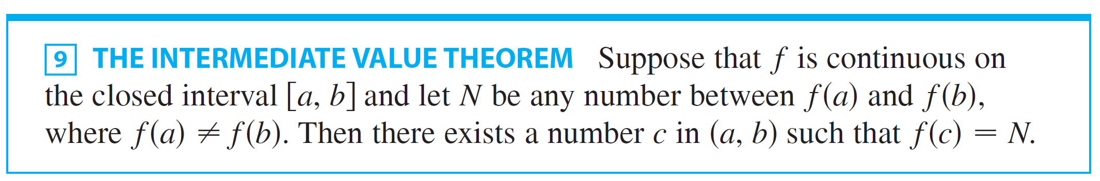
Continuity
An important property of continuous functions is expressed by the following theorem,
The theorem states that a continuous function takes on every intermediate value between the function values f(a) and f(b).

Slide 55
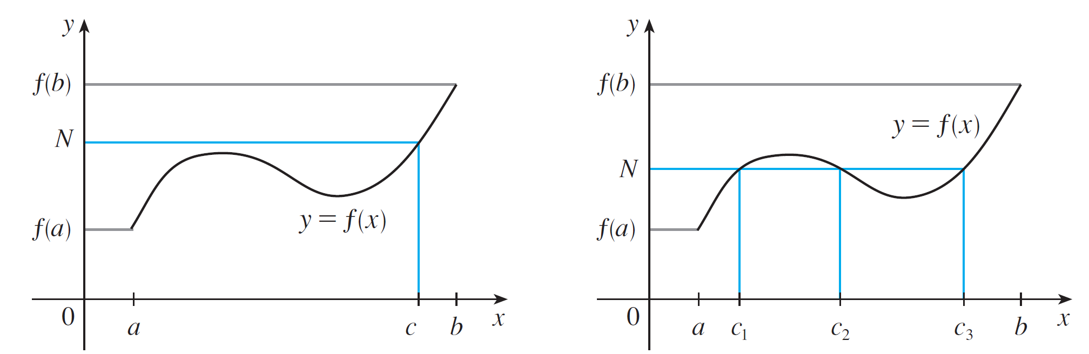
Continuity
The Intermediate Value Theorem states that a continuous function takes on every intermediate value between the function values f(a) and f(b). It is illustrated by Figure 6.
(a)
(b)
Figure 6

Slide 56
Continuity
Note that the value N can be taken on once [as in part (a)] or more than once [as in part (b)].
If we think of a continuous function as a function whose graph has no hole or break, then it is easy to believe that the Intermediate Value Theorem is true.

Slide 57
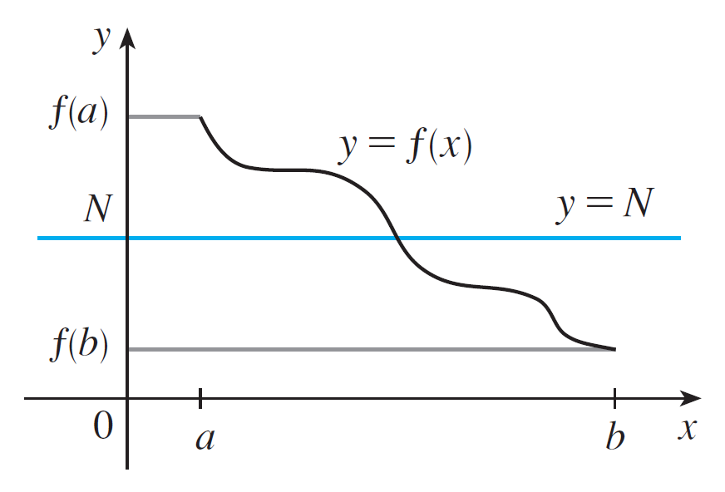
Continuity
In geometric terms it says that if any horizontal line y = N is given between y = f (a) and y = f (b) as in Figure 7, then the graph of f can’t jump over the line. It must intersect y = N somewhere.
Figure 7

Slide 58
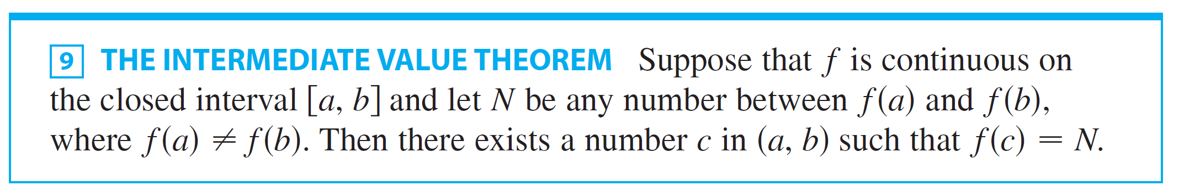
Continuity
It is important that the function f in Theorem 9 be continuous.
The Intermediate Value Theorem is not true in general for discontinuous functions.
One use of the Intermediate Value Theorem is in locating roots of equations as in the next example.

Slide 59


Example 8
Show that there is a root of the equation
between 1 and 2.
Solution:
Let .
We are looking for a solution of the given equation, that is, a number c between 1 and 2 such that f (c ) = 0.

Slide 60

Example 8 – Solution
cont’d
Therefore we take a = 1, b = 2, and N = 0 in Theorem 9.
We have
and
Thus f (1) < 0 < f (2); that is N = 0, is a number between f (1) and f (2).

Slide 61
Example 8 – Solution
cont’d
Now f is continuous since it is a polynomial, so the Intermediate Value Theorem says there is a number c between 1 and 2 such that f (c) = 0.
In other words, the equation has at least one root c in the interval (1, 2).
In fact, we can locate a root more precisely by using the Intermediate Value Theorem again.

Slide 62
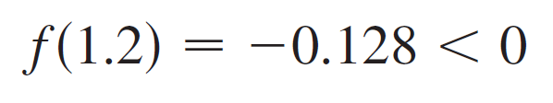

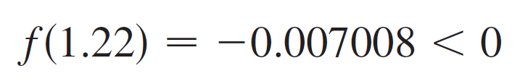

Example 8 – Solution
cont’d
Since
and
a root must lie between 1.2 and 1.3.
A calculator gives, by trial and error,
and
so a root lies in the interval (1.22, 1.23).

Slide 63
INTERMEDIATE VALUE THEOREM
We can use a graphing calculator or computer to illustrate the use of the theorem in Example 8.
The figure shows the graph of f in the viewing rectangle [–1, 3] by [–3, 3].
You can see that the graph crosses the x-axis between 1 and 2.

Slide 64
INTERMEDIATE VALUE THEOREM
The figure shows the result of zooming in to the viewing rectangle [1.2, 1.3] by [– 0.2, 0.2].

Slide 65
INTERMEDIATE VALUE THEOREM
In fact, the theorem plays a role in the very way these graphing devices work.
A computer calculates a finite number of points on the graph and turns on the pixels that contain these calculated points.
It assumes that the function is continuous and takes on all the intermediate values between two consecutive points.
The computer therefore connects the pixels by turning on the intermediate pixels.

